Slide 1
Market Basket insights
Phase 5

Slide 2
Market basket analysis is a data mining technique used by retailers to increase sales by better understanding customer purchasing patterns. It involves analyzing large data sets, such as purchase history, to reveal product groupings, as well as products that are likely to be purchased together.
The adoption of market basket analysis was aided by the advent of electronic point-of-sale (POS) systems.
Problem Definition

Slide 3
Empathy and Research:
Using Market Basket Analysis in Management Research
Market basket analysis (MBA), also known as association rule mining or affinity analysis, is a data-mining technique that originated in the field of marketing and more recently has been used effectively in other fields, such as bioinformatics, nuclear science, pharmacoepidemiology, immunology, and geophysics
Using Market Basket Analysis in Management Research

Slide 4
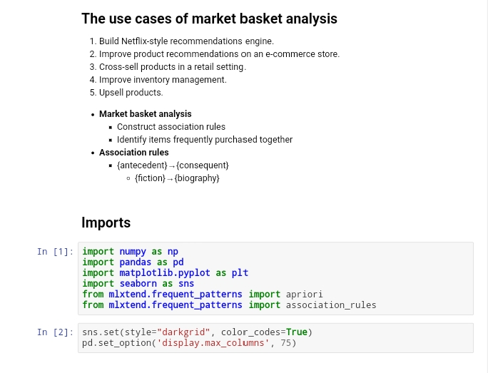

Slide 5
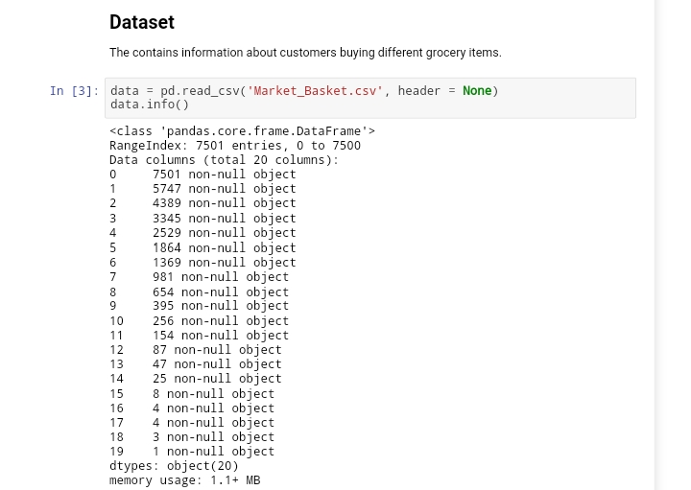

Slide 6
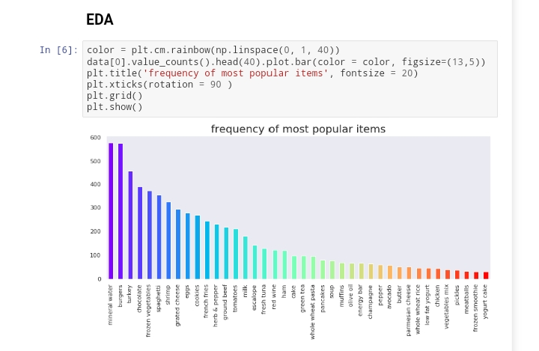

Slide 7
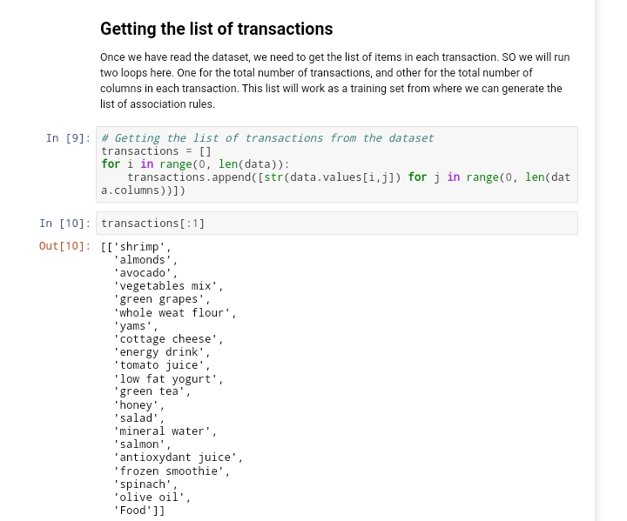

Slide 8
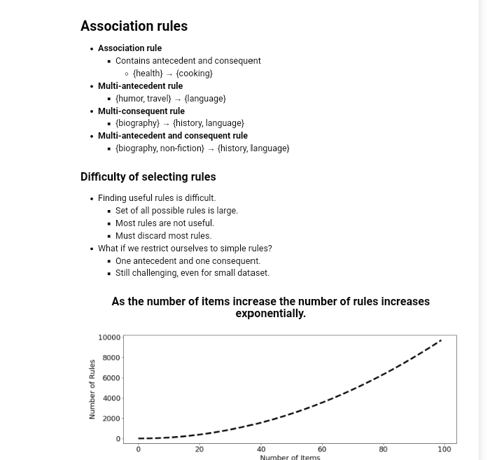

Slide 9
The specifc code for each step will depend on the programming language and libraries you’re using. If you have a partcular queston or need help with a specifc part of the process, feel free to ask!
Import pandas as pd Import numpy as np # Load the transacton data from a CSV fle (you can replace ‘transactons.csv’ with your fle)Data = pd.read_csv(‘transactons.csv’) # Display the frst few rows to inspect the data Print(data.head()) # Preprocessing steps: # 1. Handle missing values (if any) Data = data.dropna() # Drop rows with missing values

Slide 10
# 2. Convert date columns to datetme objects (if applicable) Data[‘date’] = pd.to_datetme(data[‘date’]) # 3. Perform any necessary data transformatons or calculatons Data[‘total_amount’] = data[‘quantty’] * data[‘unit_price’] # Now, your data is loaded and preprocessed. # You can perform various analysis or visualizaton tasks on this preprocessed data. Processamento de dados Python

Slide 11
What Is Data Preprocessingand Why Do We Need It?
For machine learning algorithms to work, it’s necessary to convert raw data into a clean data set, which means we must convert the data set to numeric data. We do this by encoding all the categorical labels to column vectors with binary values. Missing values, or NaNs (not a number) in the data set is an annoying problem. You have to either drop the missing rows or fll them up with a mean or interpolated values.

Slide 12
1.Load Data in Pandas To work on the data, you can either load the CSV in Excel or in Pandas. For the purposes of this tutorial, we’ll load the CSV data in Pandas.
Df = pd.read_csv(‘train.csv’) Let’s take a look at the data format below:
>>> df.info() <class ‘pandas.core.frame.DataFrame’> Int64Index: 891 entries, 0 to 890 Data columns (total 12 columns): PassengerId 891 non-null int64 Survived 891 non-null int64 Pclass 891 non-null int64 Name 891 non-null object Sex 891 non-null object Age 714 non-null foat64 SibSp 891 non-null int64 Parch 891 non-null int64 Ticket 891 non-null object Fare 891 non-null foat64 Cabin 204 non-null object Embarked 889 non-null object If you carefully observe the above summary of Pandas, there are 891 total rows but Age shows only 714 (which means we’re missing some data), Embarked is missing two rows and Cabin is missing a lot as well. Object data types are non-numeric so we have to fnd a way to encode them to numerical values.

Slide 13
>>> df.info() <class ‘pandas.core.frame.DataFrame’> Int64Index: 891 entries, 0 to 890 Data columns (total 12 columns): PassengerId 891 non-null int64 Survived 891 non-null int64 Pclass 891 non-null int64 Name 891 non-null object Sex 891 non-null object Age 714 non-null foat64 SibSp 891 non-null int64 Parch 891 non-null int64 Ticket 891 non-null object Fare 891 non-null foat64 Cabin 204 non-null object Embarked 889 non-null object If you carefully observe the above summary of Pandas, there are 891 total rows but Age shows only 714 (which means we’re missing some data), Embarked is missing two rows and Cabin is missing a lot as well. Object data types are non-numeric so we have to fnd a way to encode them to numerical values.

Slide 14
2.Drop Columns That Aren’t Useful Let’s try to drop some of the columns which won’t contribute much to our machine learning model. We’ll start with Name, Ticket and Cabin.
Cols = [‘Name’, ‘Ticket’, ‘Cabin’]Df = df.drop(cols, axis=1) We dropped three columns:

Slide 15
Expert Contributors Built In’s expert contributor network publishes thoughtul, solutons-oriented stories writen by innovatve tech professionals. It is the tech industry’s defnitve destnaton for sharing compelling, frst-person accounts of problem-solving on the road to innovaton.

Slide 16
i # libraries Import numpy asnp # used for handling numbers
Import pandas aspd # used for handling the dataset From sklearn.impute import SimpleImputer # used for handling missing data From sklearn.preprocessing import LabelEncoder, OneHotEncoder # used for encoding categorical dataFrom sklearn.model_selecton import train_ test_split # used for splitng training

Slide 17
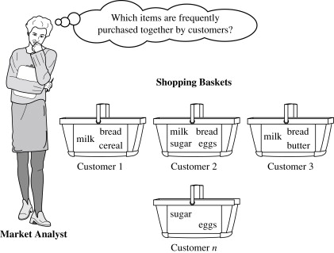

Slide 19
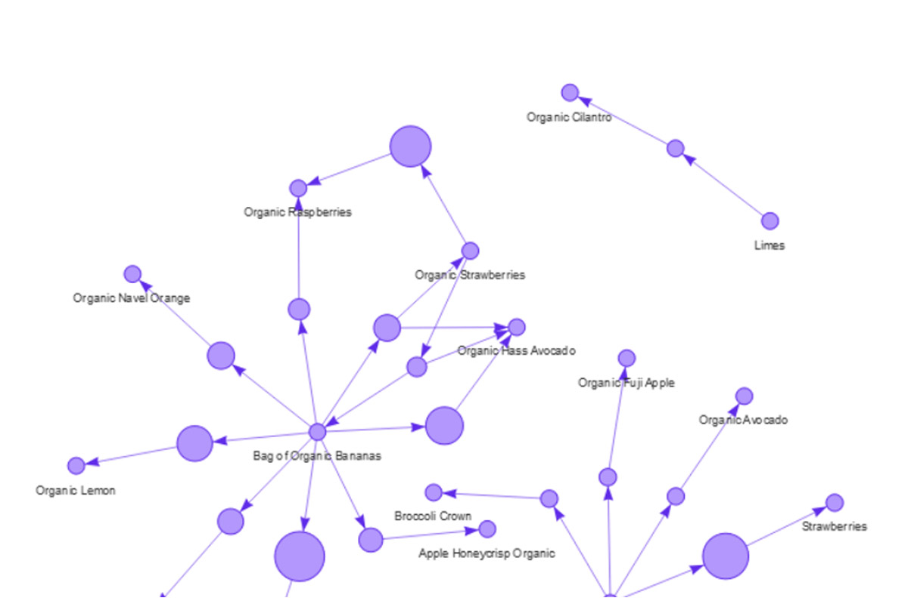

Slide 20
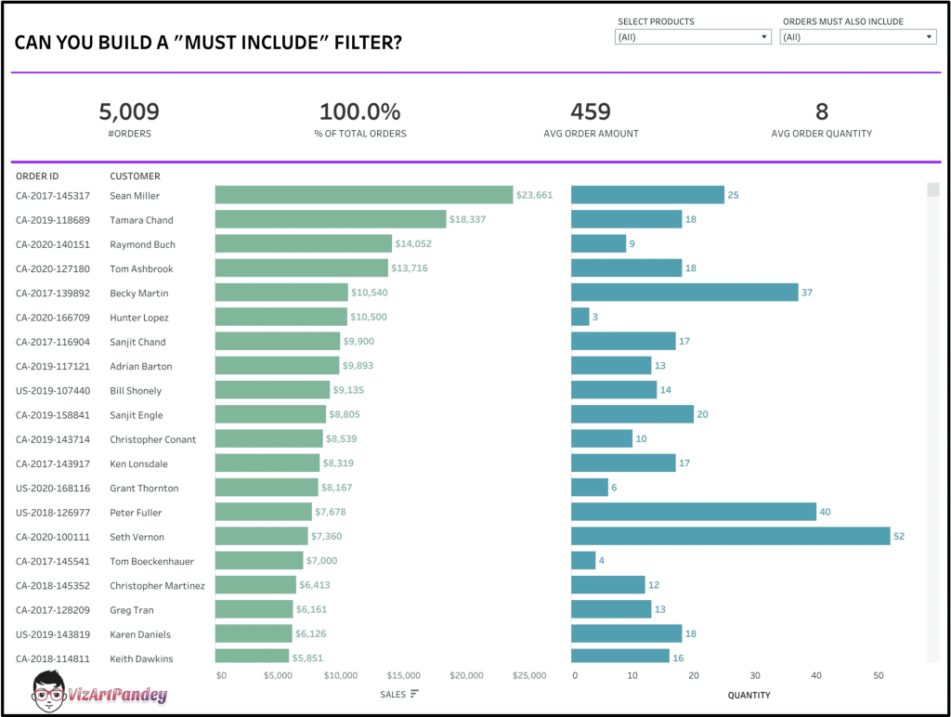

Slide 22


